Slide 1
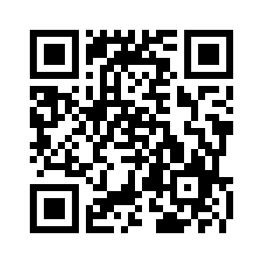
Society of Women Engineers
Join our ListServ!!
Go to https://list.arizona.edu/sympa/subscribe/swe OR use snapchat to read the QR code above and just enter your email address!

Slide 2
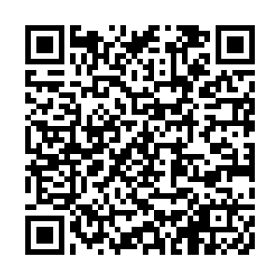
Attendance

Slide 3
The Society of Women Engineers
University of Arizona
October 24, 2018

Slide 4
Agenda
Announcements
Pumpkin Carving

Slide 5
Announcements

Slide 6
SWEeties!
Fall Photo Shoot at Old Main!
November 3rd (Next Saturday)
Photos will be uploaded to Google Drive
Start at 11:00 a.m. end around 12:30/1:00 or until we finish taking photos
RSVP in the email
Outfit inspiration →
(boots, sweaters,
jeans, scarves, etc)

Slide 7
Shadow a SWEester
November 6th, 2018
8:00am - 3:30pm
Mark you calendars!
Look out for meet-up emails from me later this week
If you do not have a GroupMe, please make one! It is free :)
If you have not signed up, and you are interested, let me know after the meeting
Note: This is a Tuesday this year!!

Slide 8
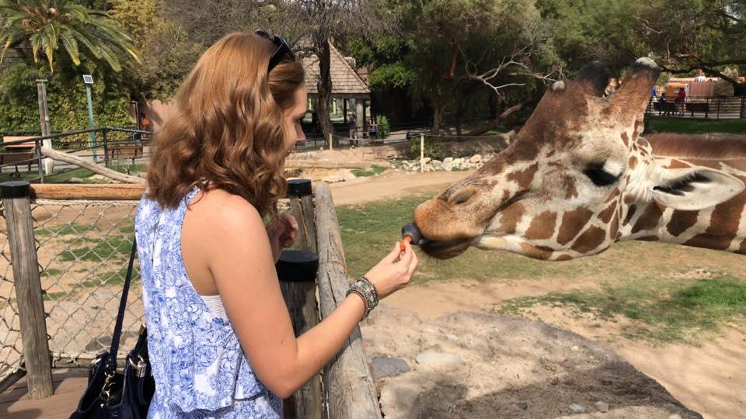
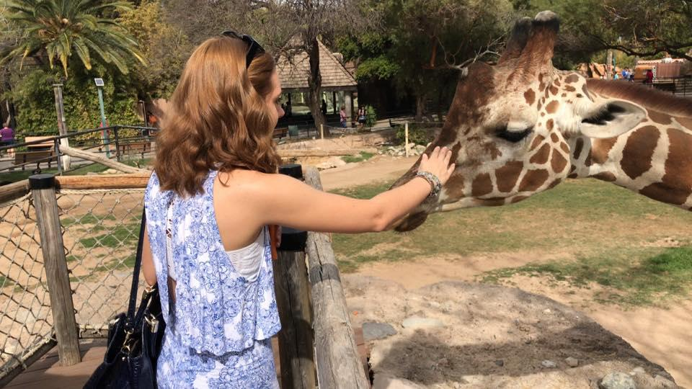
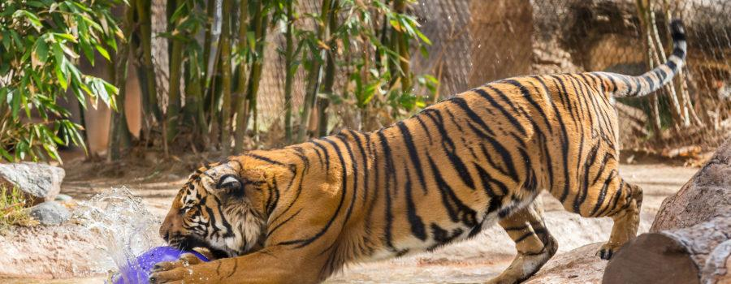
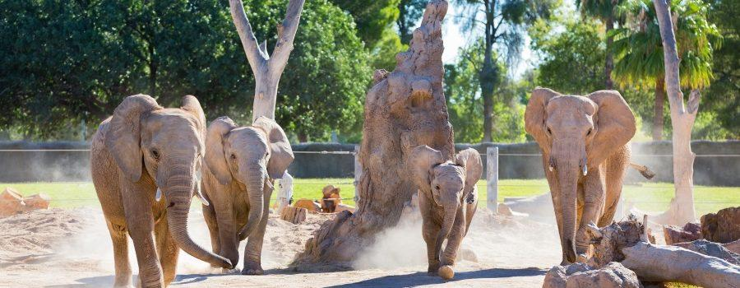
Our Reid Park Zoo Social!
Trying to determine date that best works for everyone due to holiday weekend
Giraffe encounter!!
Please fill out and submit the google form by Oct. 24th at midnight!
https://goo.gl/forms/3wLeGFzslLR7VFgf1

Slide 9
External Branch Committee
Congratulations to…
Paige Sawyers, Madison Sitzkiewicz, and Kaitlyn Molloy!
Thank you to all who applied!

Slide 10
Tucson SWE Section Scholarship
Award Amount: $500
Essay Topic: (500-1000 words) What have you learned from being involved with SWE and/or other U of A organizations? How do you think this knowledge will help you in the future as you explore your educational/career goals?
Must be a UA Engineering major, a nationally paid SWE member, and not graduating this May
Due November 1st

Slide 11
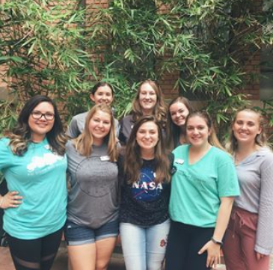
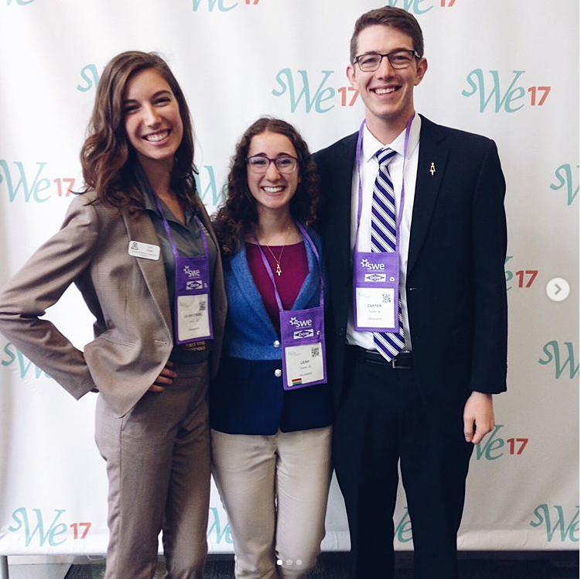
Social Media Shoutouts
Did something cool this summer? Want to recognize another student or faculty member that is doing something awesome?
Take an artsy pic of something engineering related?
Send me a picture and a description, and I will feature it on our social media accounts! You may even be feature on the UA Engineering Page!
Email: jsofka@email.arizona.edu Phone: (480)528-5832

Slide 12
Next Meeting November 7th 6pm ENGR 210

Slide 13
Get Info on Everything Going on in UA SWE
Connect with us over social media at:
Website: www.arizona.swe.org
Facebook Page: UA Society of Women Engineers
Facebook Group: UofA SWEsters!
Instagram: @ua_swe
LinkedIn: University of Arizona Society of Women Engineers
SWE Tucson Section: www.swetucson.org

Slide 14
Get on our Listserv!
The best way to receive updates on upcoming events
Go to our website Arizona.swe.org
Select ‘How to get involved as a Collegiate Member’
Click Entry Form “here” to go to page and add email

